Slide 1
Cost Accounting
Sylvie Appriou
July 25th, 2018

Slide 2
Agenda
Purpose of Cost Accounting
Example
Making profit vs building up Sales volume
Types of manufacturing costs
Standard costs
ABC costing

Slide 3
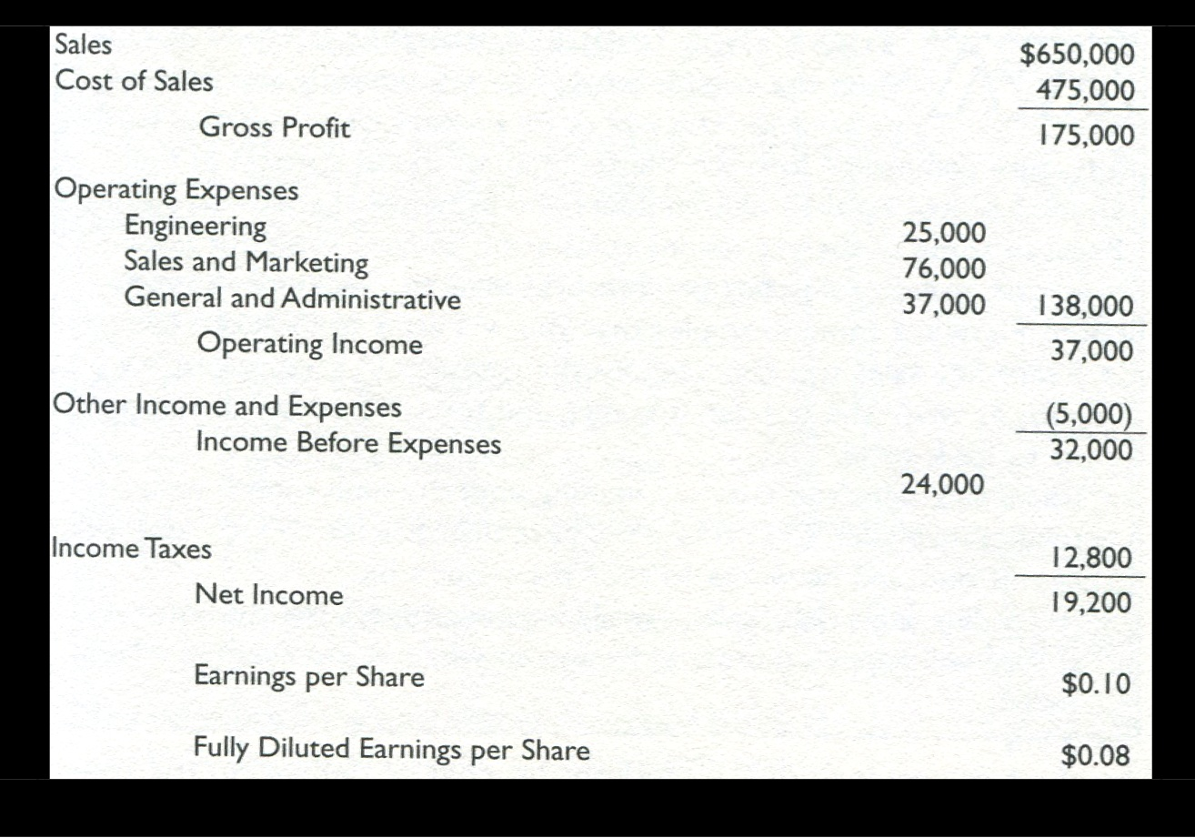
Income statement

Slide 4
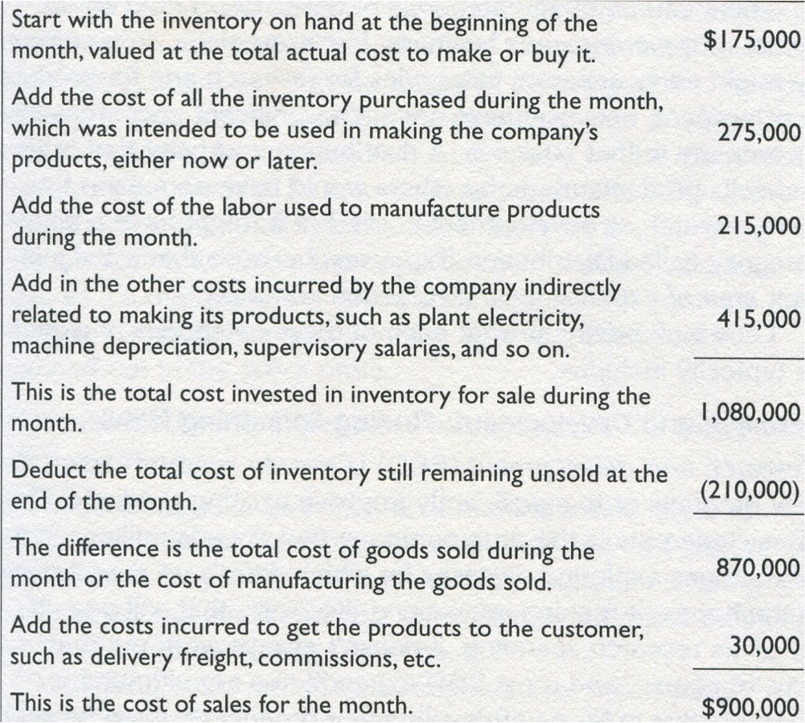
Cost of Sales

Slide 5
Purpose of Cost Accounting (1/2)
Cost Accounting is to protect and grow Gross Profit while maintaining the quality of its product or service to an acceptable level
It is about understanding Cost of Sales
Most valuable for manufacturing companies but principles apply to all businesses

Slide 6
Purpose of Cost Accounting (2/2)
Amazingly enough, many companies do not really know whether or not they are making a gross profit on many of the products they sell…
  It is simple for a company to determine if they are making a gross profit over all its product sales…
  If company makes a number of products, each with different cost structure or complexity, Managers may not know how much each product contributes to (or subtracts from…) from the overall Gross Profit

Slide 7
Example (1/2)
Company making 2 products :
  WW-1000 selling for 425$
  WW-Super-1000 for 575$
Same sales : 1,000 unit / month
Total sales of 1,000,000 generates a gross profit of 250,000$
Don’t have visibility to each product costs : realize that WW-Super 1000 is more complex to manufacture but as they charge more for it, believe it is OK…

Slide 8
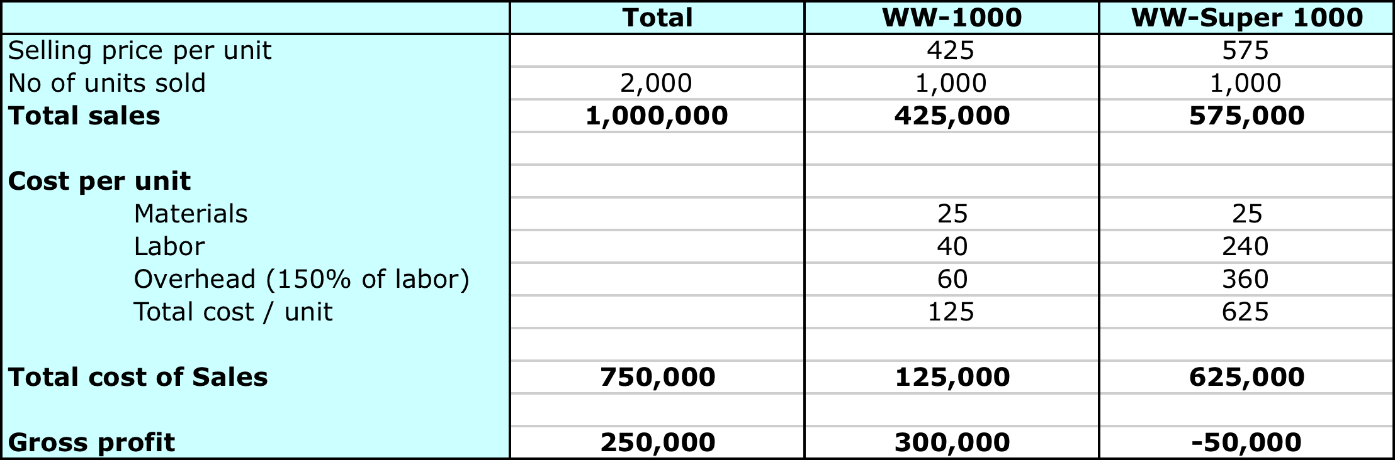
Example (2/2)
When looking at the numbers :
The best revenue producer is loosing money…
They could make 50,000$ more, ie increase their gross profit by 20% if they would just stop making the deluxe version !

Slide 9
Making Profit vs Building up Sales volume
« We are loosing money on every piece but we are making it up on volume »
…not so funny…
Cost accounting is a complex topic requiring extensive data collection
  Timecards from factory workers : which products do they spend their time on ?
  BOMs Bill of Material : all materials required to perform a certain manufactuing job
  Material requisitions to track all materials issued to the job, includes damaged or scrapped and material to replace them
  Job cost sheet that follows a job thru the factory and on which production costs are recorded as they are incurred…

Slide 10
Types of manufacturing costs (1/4)
Direct vs Overhead
Direct materials : raw material that go directly into making the products
  Example to manufacture a chair : wood, fabric, screws and glue
Direct labor : wages paid to workers directly employed in manufacturing products or in providing the services for customers
Manufacturing overhead : all the costs necessary to operate the business that are not classified as direct labor or direct material. Often referred as « Indirect costs »
  Rent, insurance, utilities, supervisors : not charged directly to the jobs but grouped together and allocated based on direct labor hours worked on the jobs

Slide 11
Types of manufacturing costs (2/4)
Fixed vs Variable costs
Fixed costs: remain unchangd even though the business increases its volume of sales
  Rent, asset depreciation
Variable costs: increase in direct relationship to sales volume
  Direct material, direct labor, packaging material
Semi fixed costs: increase in relation with Sales but at a lower pace
  Manufacturing scrap pickup service (will not increase until more truks are needed…)

Slide 12
Types of manufacturing costs (3/4)
Fixed vs Variable costs
If variable costs increase faster than sales, means inefficiencies in the process that need to be investigated
If variable costs do not increase as quickly as sales may be unrecorded expenses

Slide 13
Types of manufacturing costs (4/4)
Controllable vs non controllable
Controllable : costs that responsible managers can easily control :
  Travel, marketing expenses, amount of inventory purchased, telephone charges
  Managers can lower or eliminate
Non controllable costs
  Income tax, depreciation, rental or lease payments
  Managers cannot lower or eliminate
Managers should be held accountable for controllable costs
Can argue that short term all costs are uncontrollable and long term all are controllable…

Slide 14
Standard costs (1/3)
Challenge of Cost Accounting is to determine the actual cost of a unit of finished goods
Timing of reporting is critical
  Need to provide costs for the products manufactured during the month soon after the end of the month to include in Financial statement
  If it takes months to produce costs reports, we’ll not be able to analyse and make corrections quickly enough
Short term answer to this question is « Standard cost » vs « Actual cost »
  Standard cost is an estimate of Actual cost assuming efficient plant operations at normal capacity
  Standard costs and Actual costs are then compared and causes of variances are explained : this is variance analysis

Slide 15
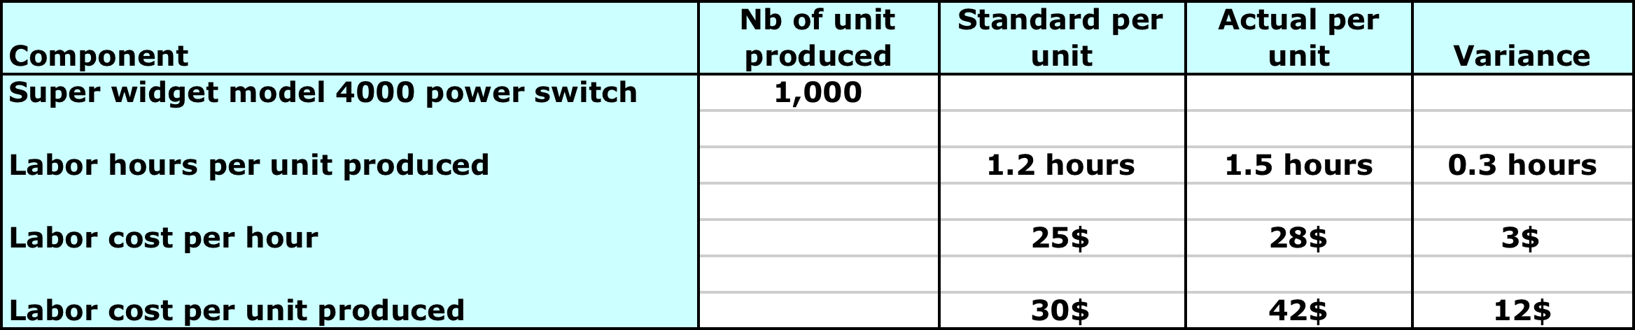
Standard costs (2/3)
2 type of variances
  Price variance : material or labor used for production costed more by unit than what was anticipated
  Usage variance : production run consumes more of the material or labor than what was projected
Example

Slide 16
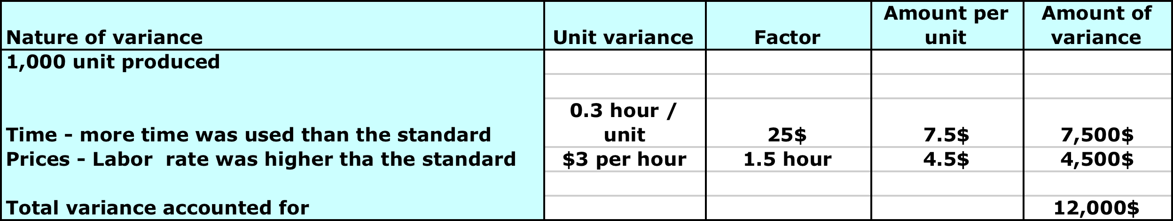
Standard costs (3/3)
Analysis of cost variance
What explains these variances ? Are they « one off » that relate to a specific situation or should we increase the standard ?

Slide 17
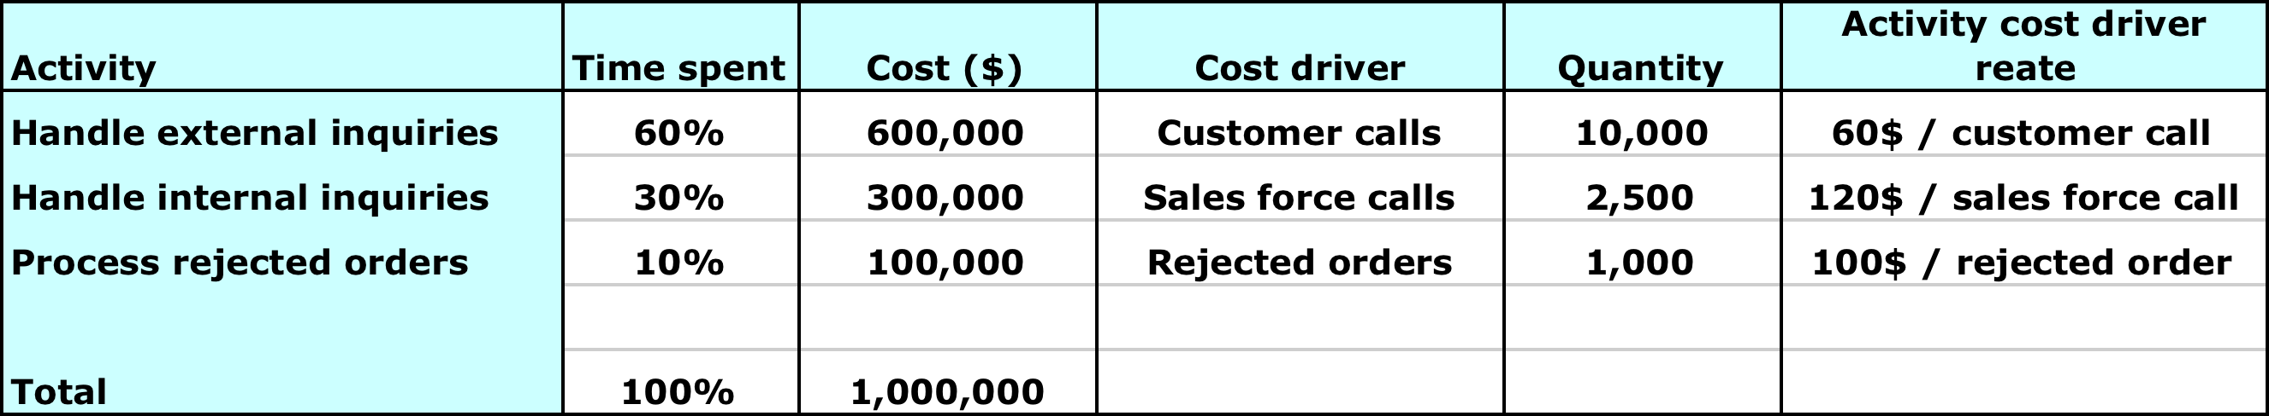
ABC costing (1/3)
Activity Based Costing : method for assigning costs to products and services based on the activities required to produce them
Example : Customer Service department in a B to B telco with a team of multi skilled call center agents who handle both external customer inquiries and internal inquiries from the Sales force. In addition, they correct orders that have wrong or missing information by calling customers

Slide 18
ABC costing (2/3)
Data is gathered
  …by interviewing agents doing the work : how much time do you spend on each activity ?
  …then counting the number of cost drivers
  …then factor in the cost of the department that is 1,000,000$ / year
There is a number of inaccuracies and complexities in the model :
  Time spent is based on people’s subjective estimates of their behaviour and assumes 100% productivity with no idle time
  Any change in activities and processes would require re-interviewing and maintenance of the model
  If approach is applied to a large number of people and many activities more complex than in the example, the effort and cost involved in interviewing people, stting up and maintening the model could soon become prohibitive

Slide 19
ABC costing (3/3)
In conclusion, ABC costing is more suited to relatively stable industrial, commodity type processes with little exception processing
It would also need to be a high volume activity to justify the overhead of maintaining an ABC system

